Slide 1




HOUSE PRICE PREDICTION
PROJECT.
PRESENTED BY: JAMES KIMANI
GROUP 11

Slide 2


CONTENT
01
02
03
04
Problem Statement
Project Objective.
Data Understanding
Introduction
05
06
07
Data Modeling Results
Recommendations
Conclusion

Slide 3


PROBLEM STATEMENT
The goal of this project is to provide valuable insights to a real estate agency, which aims to offer data-driven recommendations to homeowners regarding home renovations and their potential impact on the estimated value of their properties.

Slide 4



OBJECTIVES.
01
Utilize multiple linear regression modeling to analyze the King County House Sales dataset and identify key factors influencing home prices.
02
Offer personalized recommendations to homeowners regarding the types of renovations or improvements that could potentially increase the estimated value of their homes.

Slide 5

OUR DATA.
This project uses the King County House Sales dataset

Slide 6

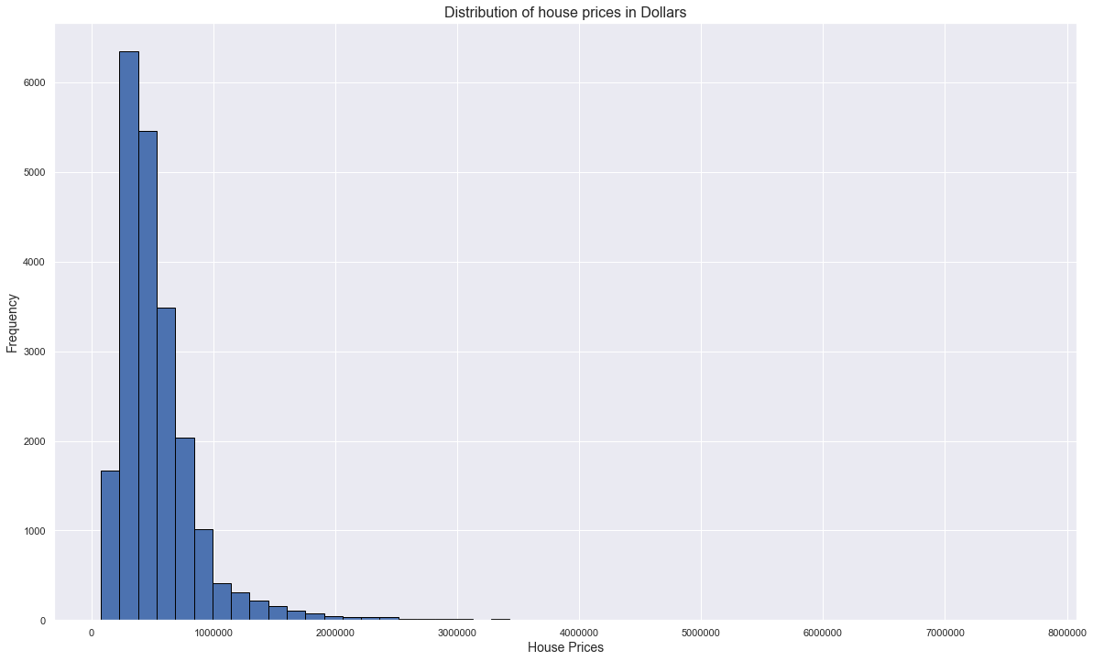
DATA UNDERSTANDING
Based on our data and the Histogram above, House Prices are positively skewed, meaning that: Mode < Median < Mean

Slide 7
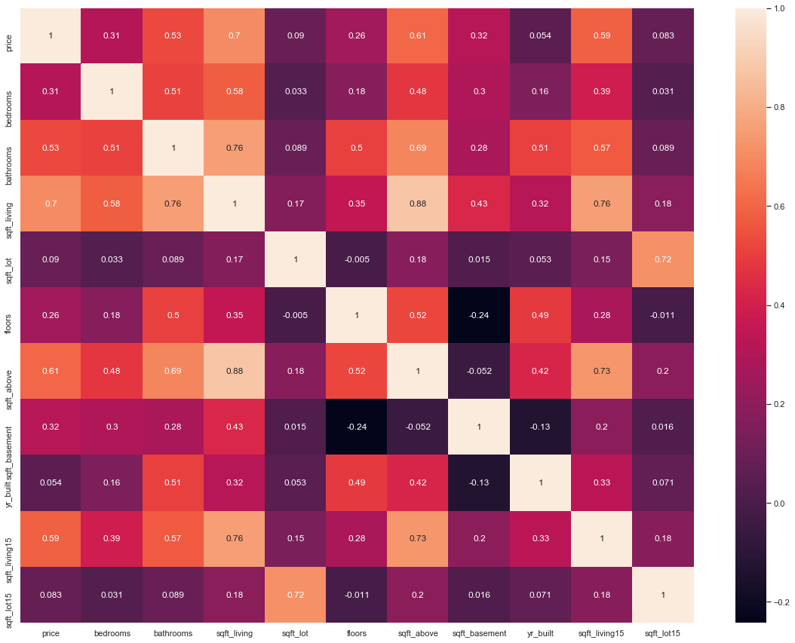
CORRELATION MATRIX.
Based on the correlation matrix, it can be observed that the Square footage of living space other than the basement has the highest positive correlation to the price of 0.70.Which is a strong correlation.
Additionally, the yr_build variable had the least correlation of 0.054

Slide 8
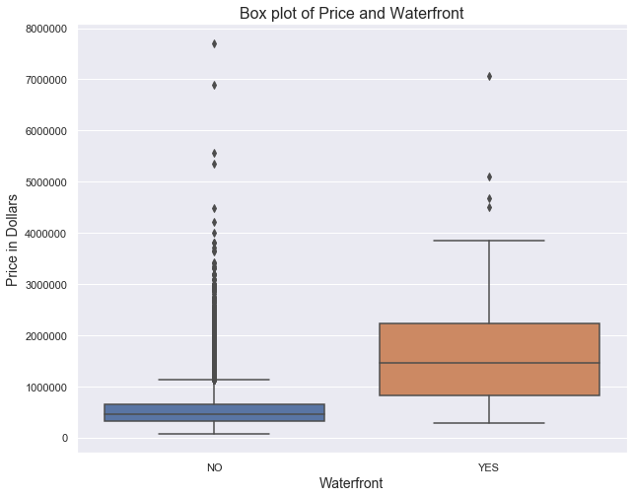
PRICE VS WATERFRONT
From the Box plot above, we can observe that the price of a house tends to be higher when the house has a waterfront.
Additionally, houses that do not have a waterfront tend to have more outliers than those with waterfronts

Slide 9
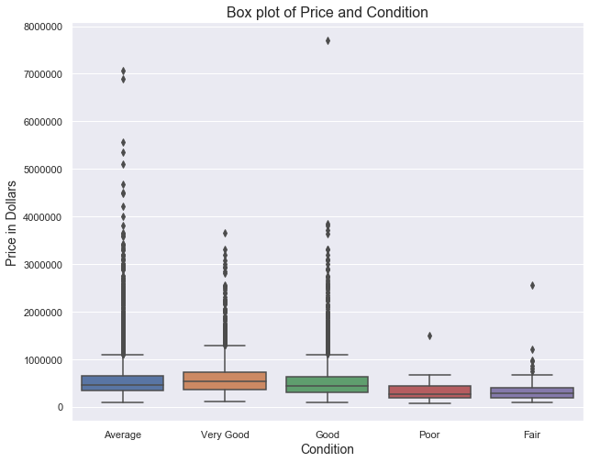
PRICE VS CONDITION.
Based on the correlation matrix, it can be observed that the Square footage of living space other than the basement has the highest positive correlation to the price of 0.70.Which is a strong correlation.
Additionally, the yr_build variable had the least correlation of 0.054

Slide 10
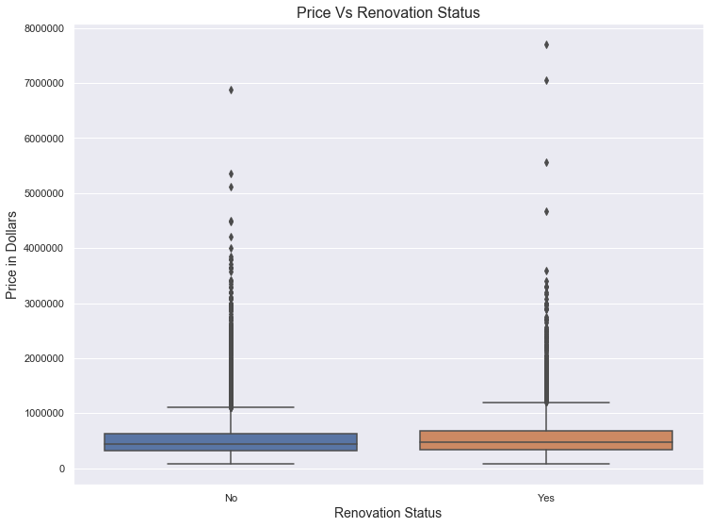
PRICE VS RENOVATION STATUS
Based on the correlation matrix, it can be observed that the Square footage of living space other than the basement has the highest positive correlation to the price of 0.70.Which is a strong correlation.
Additionally, the yr_build variable had the least correlation of 0.054

Slide 11


REGRESSION MODELING
Simple Linear Regression
Multiple Linear Regression
We model our price against the independent variable with the higest correlation
Through an itterative proces, we include as many predictive variables to the model.

Slide 12
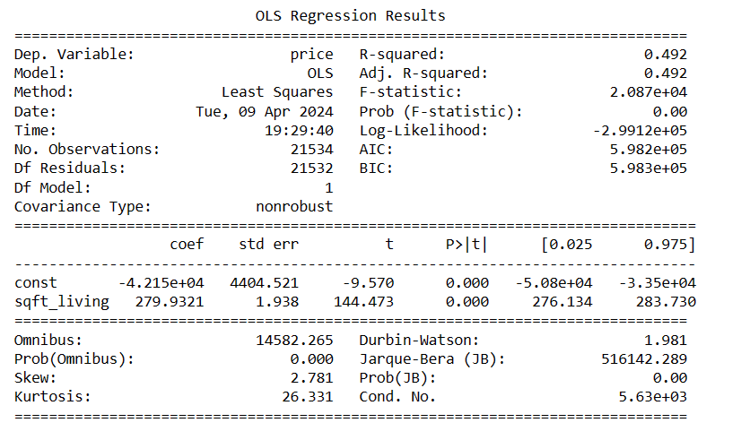
SIMPLE LINEAR MODEL
Comments.
Our Model and coefficient are statistically significant because the F-value is less than our assumed alpha of 0.05.
Our Adjusted R Squared is 0.493, hence the model explains 49.2% of the variance in price, the target variable.
For a square foot living of 0, our model would predict a price of -0.0004399 dollars. An increase of 1 square-feet living, would increase the price by 280.

Slide 13
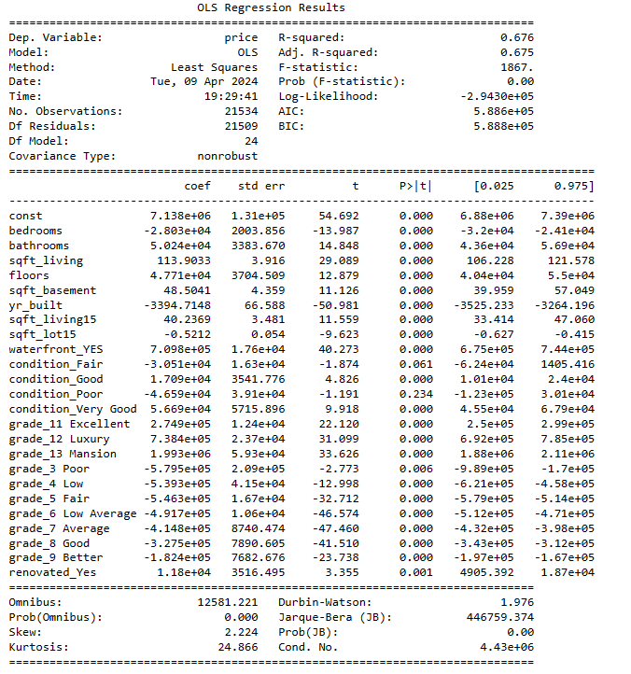
MULTIPLE LINEAR MODEL
Comments.
1. Our Model and coefficient are statistically significant because the F-value is less than our assumed alpha of 0.05.
2. Our Adjusted R Squared is 0.676, hence the model explains 67.6% of the variance in price, target variable.

Slide 14
OBSERVATIONS
01
R-Squared Value. The R-squared value of 0.676 indicates that the model explains approximately 67.6% of the variance in the target variable (price). This suggests that the model has a moderate level of explanatory power.
02
Significance of Predictors. Several predictors have statistically significant coefficients. That is the calculated P-values are less than the assumed alpha of 0.05 indicating that they have a significant impact on the price of houses
03
Coefficient Interpretation: The coefficients represent the change in the target variable (price) for a one-unit change in the predictor variable, holding all other variables constant.
04
Intercept: The intercept term (const) represents the expected price of a house when all predictor variables are zero.

Slide 15
OBSERVATIONS
05
Positive/Negative Coefficients: Positive coefficients indicate a positive relationship between the predictor variable and the price of houses, while negative coefficients indicate a negative relationship.
06
Waterfront Variable: The coefficient for the waterfront variable is particularly large, suggesting that houses with waterfront views have a substantial impact on price.
07
Grade Variable: The grade variable includes multiple categories, each representing different levels of house quality. Higher-grade categories have positive coefficients, indicating that houses with higher quality grades tend to have higher prices.
08
Renovated Variable: The coefficient for the renovated variable (renovated_Yes) is positive and statistically significant (p < 0.05), suggesting that renovated houses tend to have higher prices compared to non-renovated houses.

Slide 16





RECOMMENDATIONS
01
02
Consider Waterfront Properties.
Focus on Grade
Given the significant impact of waterfront properties on price, buyers interested in premium properties may prioritize houses with waterfront views.
Buyers seeking high-quality houses should pay attention to the grade variable, as higher-grade categories tend to command higher prices
03
04
Evaluate Renovated Properties
Further Analysis
Sellers may benefit from renovating their properties, as renovated houses tend to have higher prices. Buyers should also consider renovated properties when looking for houses with increased value potential.
Conduct further analysis to explore potential interactions between predictor variables and identify any additional factors that may influence house prices.

Slide 17

OUR TEAM
Sammy Warah
sammy.warah@student.moringaschool.com
James Kimani
james.irungu1@student.moringaschool.com
Dorothy Chomba
dorothy.chomba@student.moringaschool.com
Wilfred Likishorumingi
wilfred.lekishorumongi@student.moringaschool.com

Slide 18






THANK'S FOR WATCHING

